Slide 1

CAN I haz car secret plz?
Cyber
Javier Vazquez Vidal
Henrik Ferdinand Nölscher

Slide 2
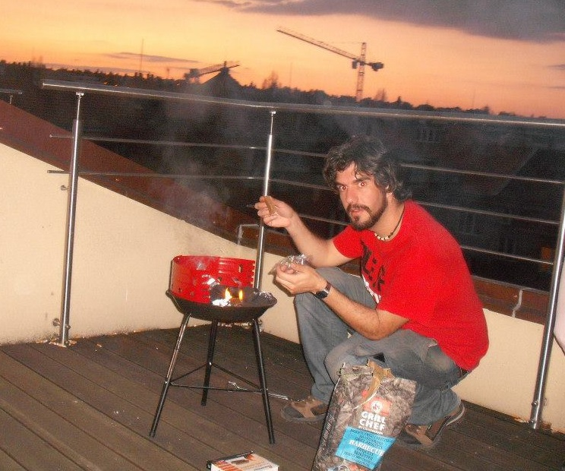
Who are we?
Javier is a Hardware Security Specialist
Works at Code White as a Product Security Engineer
He is from Cadiz (Spain)
Enjoys reversing products that are interesting, or could potentially be more fun
Likes cake (when it’s not a lie) and bbqs

Slide 3
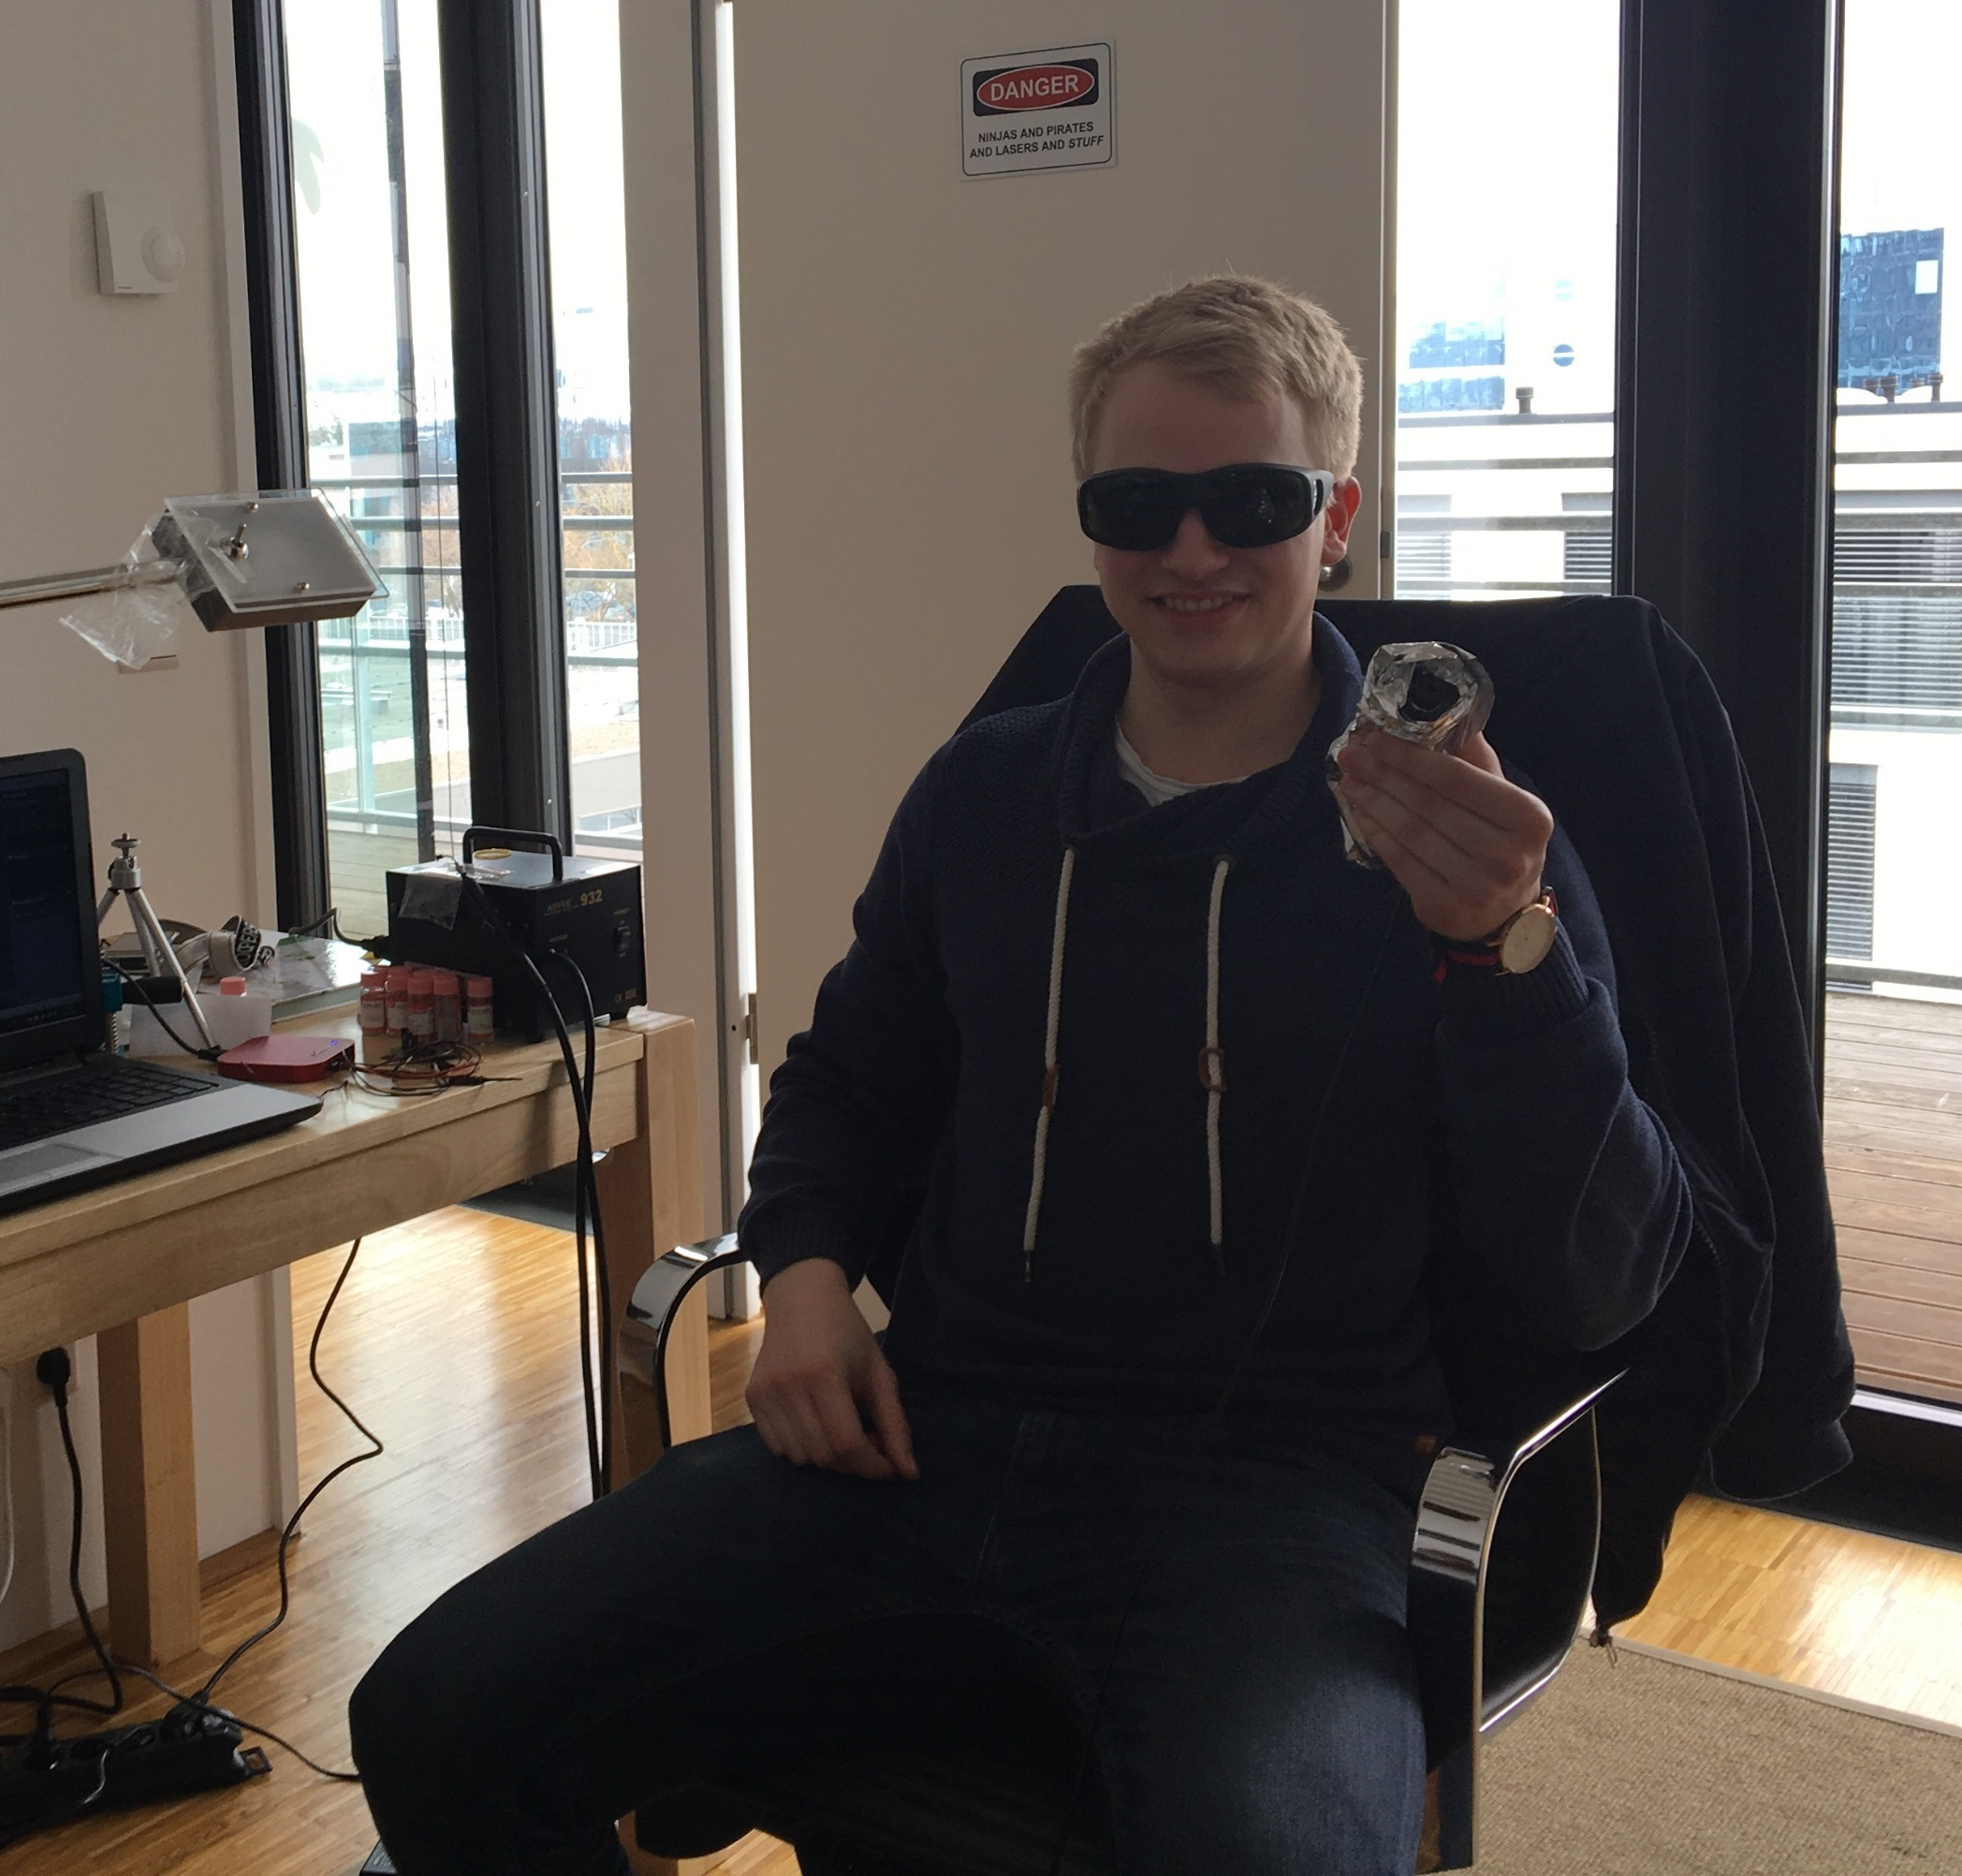
Who are we?
Ferdi works as an Information Security Specialist at Code-White in Ulm
Among many things, he likes pwning stuff, lasers and BBQs
Likes big busses and he cannot lie

Slide 4
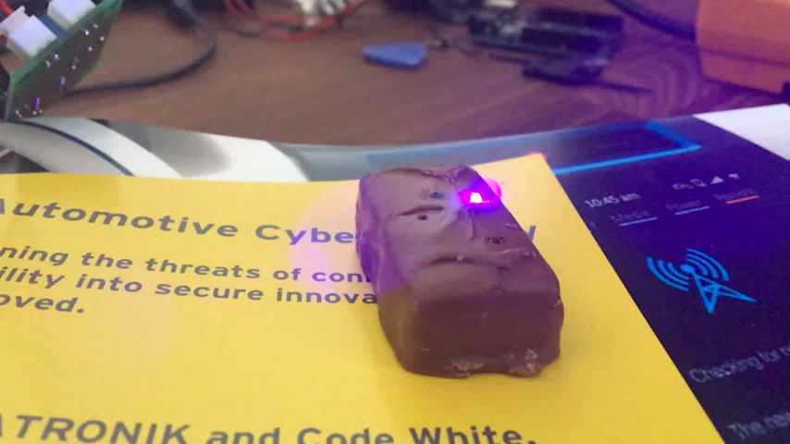


What options did we have?

Slide 5
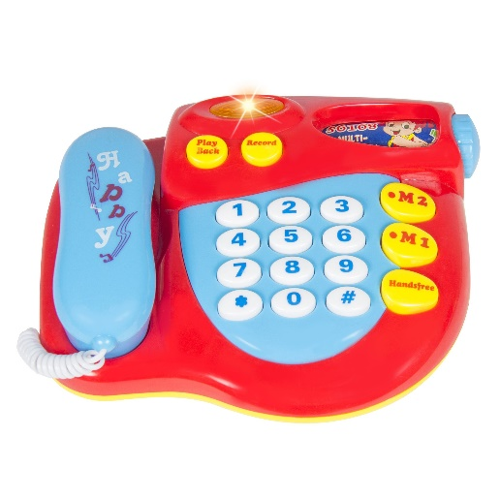
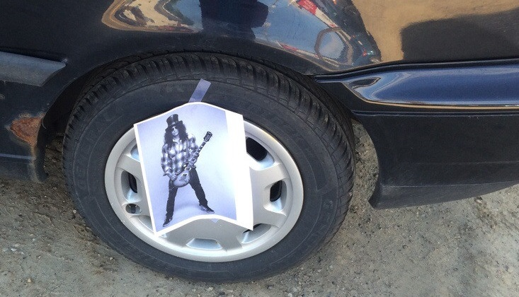
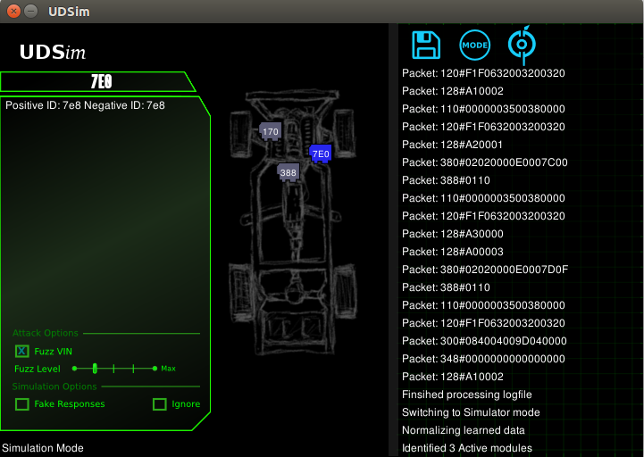
Current Car Hacking status
Focus is on the CAN bus
Replay attacks and/or packet injection
Some researchers also found remote exploits to take control of certain vehicles
There are some tools to help understand the UDS protocol
Notes:
Ferdi:
Abbreviate, no need to use full sentences all the time

Slide 6
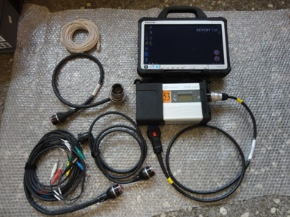
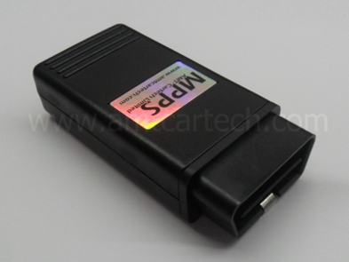
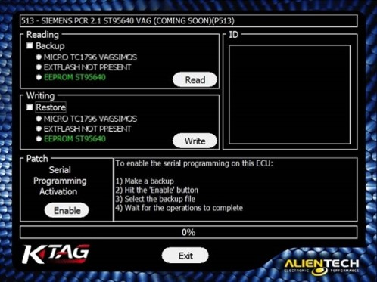
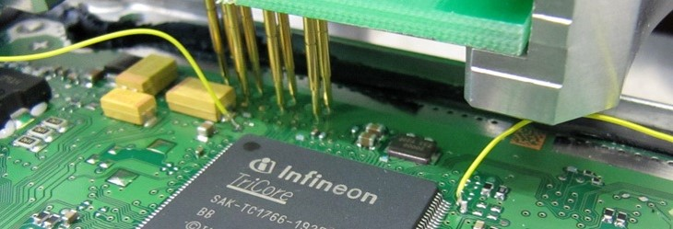
Is there anything else?
Chiptuning is actually hacking
ECUs are cloned
Internal data is manipulated
OEM specific Diagnostics are more fun than standard ones

Slide 7

So, what’s the secretz?
UDS is not the only protocol
TP2.0 (Tunneling Protocol) is the CAN version of KWP2000
Both offer a series of services which are very interesting, but often not taken into consideration.
With use of these services, a lot of Information can be gathered and modified.

Slide 8
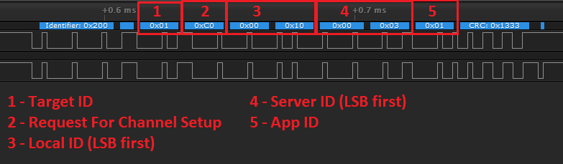
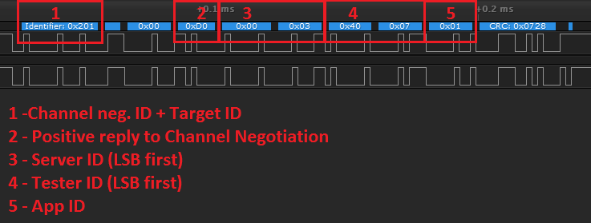
UDS VS TP 2.0 -> TP 2.0 Channel Negotiation

Slide 9
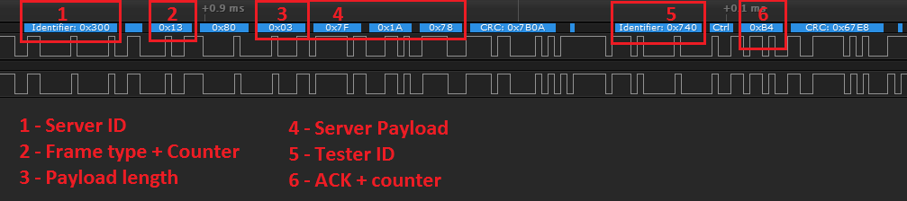
UDS VS TP 2.0 -> TP 2.0 Transmission

Slide 10
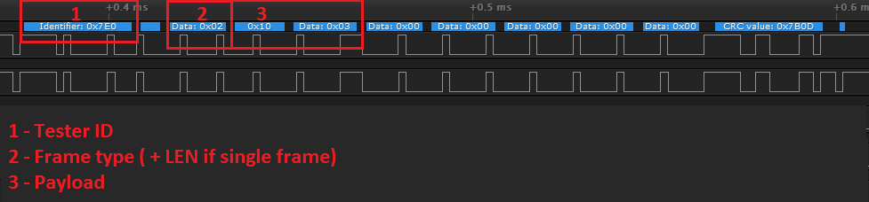
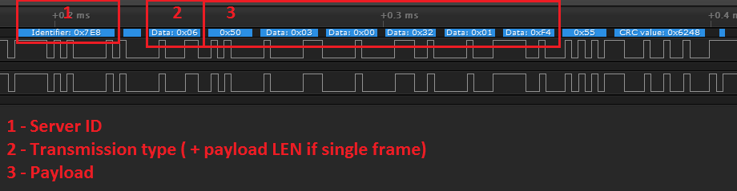
UDS VS TP 2.0 -> UDS Transmission

Slide 11
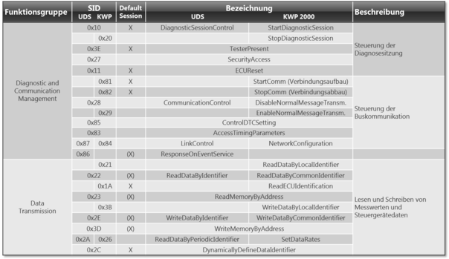
Some of the differences between UDS and TP SIDs
Notes:
Changed title to: The Difference between UDS and TP. We dont really need this slide

Slide 12
The most interesting Services
SecurityAccess (0x27): Allows access to restricted Services
ReadMemoryByAddress (0x23): Allows to read certain memory addresses
Read/WriteDataByID(0x22/0x2E): Allows to read/write certain parameters
RequestUpload(0x35): Service used to retrieve firmware from the ECU
RoutineControl(0x31): Allows to start “routines”, which have different effects
Notes:
This is good but it would look waaay better if it was a table/graphic

Slide 13
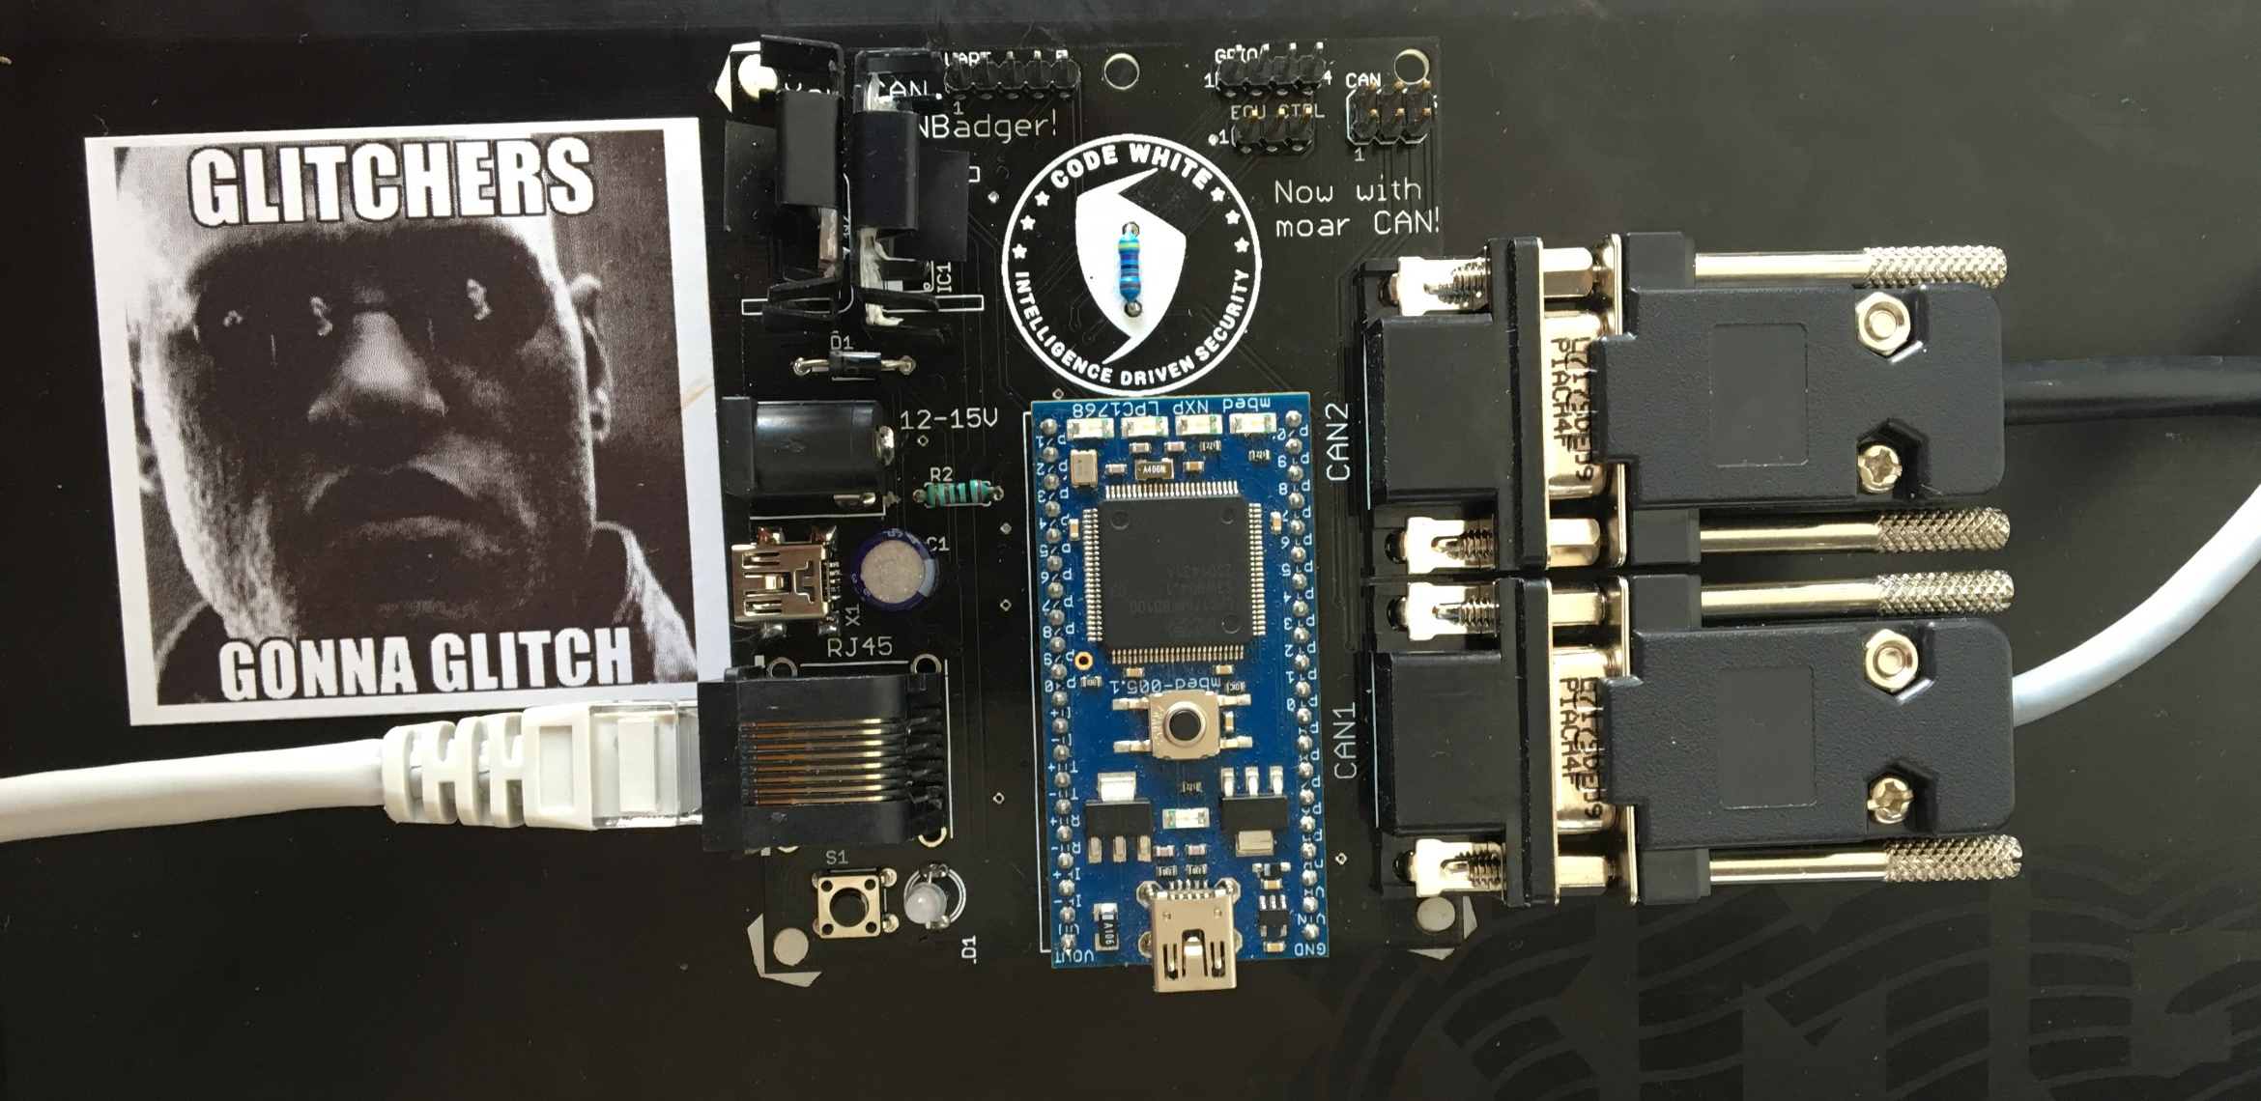
Say hello to the CANBadger!

Slide 14
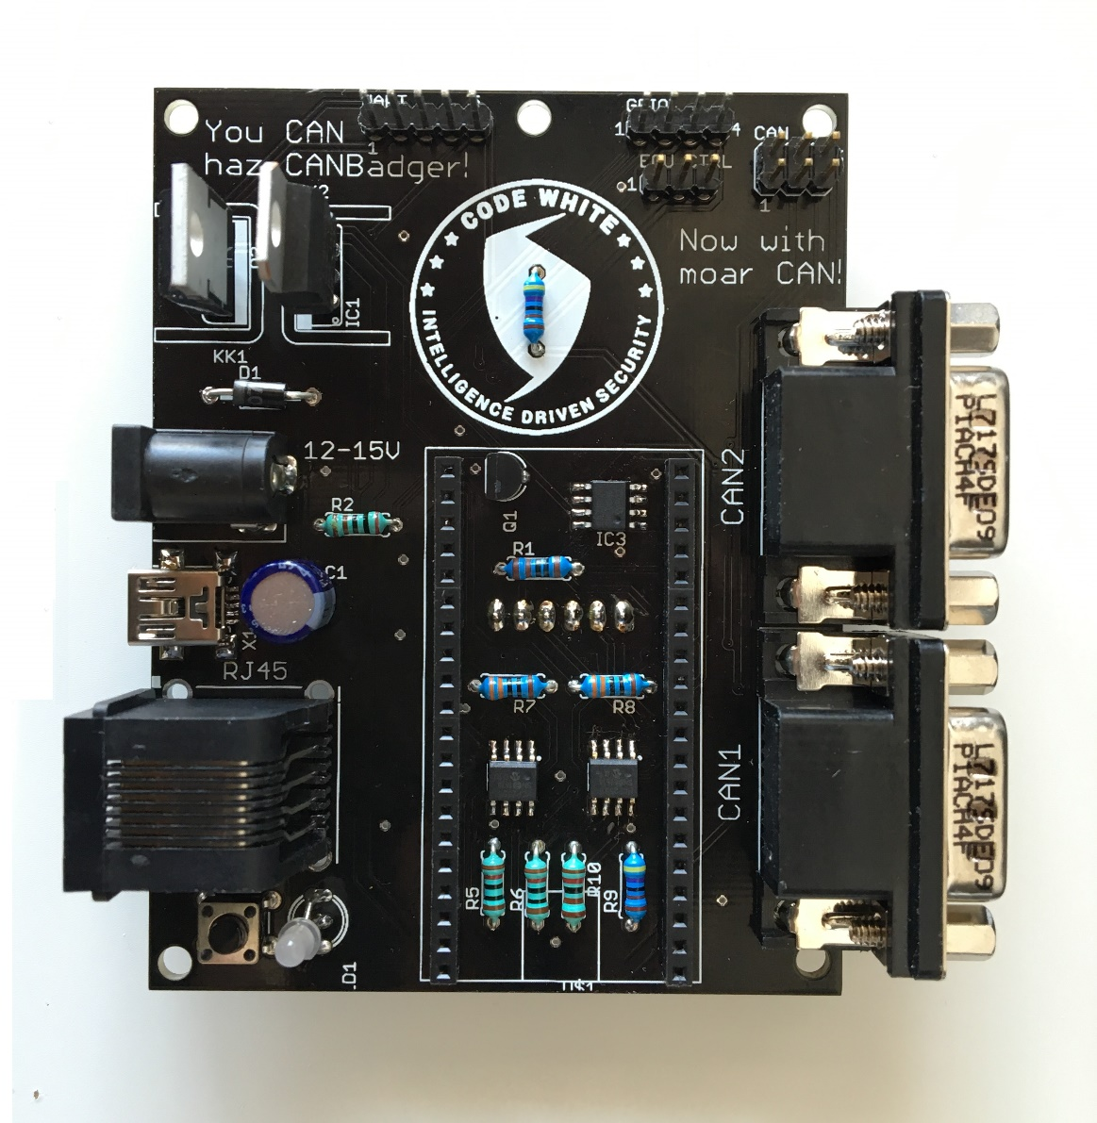
CANBadger Hardware Overview
Powered by mBed LPC1768 or LPCXPresso LPC1769
128KB XRAM
2x DB9 CAN Interfaces + 2x Debug headers
SD card
ECU Power control by software
UART
4 GPIOs
Standalone mode, USB mode (CDC Device), or Network mode
Can be powered by PSU, External battery, or OBD2
Has a blinky dual color LED. Everyone loves blinky LEDs, right?
Complete board assembly under $25

Slide 15

CANBadger POC Firmware Features
All actions are handled by the CANBadger firmware
Supports UDS, TP2.0 and RAW CAN
Diagnostics Sessions are interactive (realtime)
MITM with rules stored in SD
Hijack SecurityAccess
Emulate SIDs/PIDs from log
Dump Data Transfers to SD
Log UDS and TP2.0 traffic with very detailed verbosity in standard or bridge mode
Log RAW CAN traffic in standard or bridge mode
Detect CAN speed
Ethernet for use with GUI
Notes:
Bulletpoint madness. No one will read this, so either we skip it very fast or abbreviate it to avoid confusion.
I think that we can just dump this slide and rather talk about the features in specific. Or even better: Just show the features we are talking about and on the cd, we leave it as is so ppl on the internet get to read everything

Slide 16
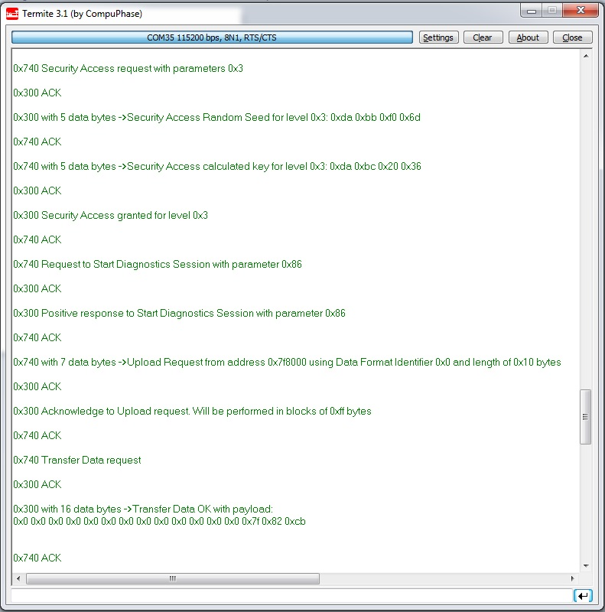
Protocol Analysis
Many SIDs already included in firmware
Extremely fast to add support for new SIDs
High verbosity
Logging and parsing is done by the CANBadger firmware
Logs are stored in the SD card and can be viewed and retrieved without removing it
Works with UDS and TP2.0
Notes:
Abbreviate sentences

Slide 17
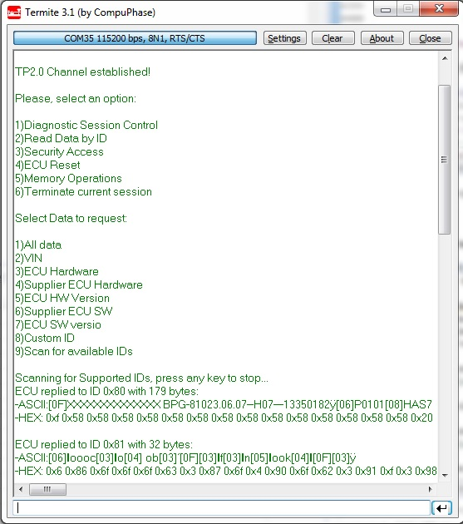
TP2.0 and UDS Interactive Session
No scripting required
Allows to perform actions on the go
Built-in scanners for SID parameters

Slide 18
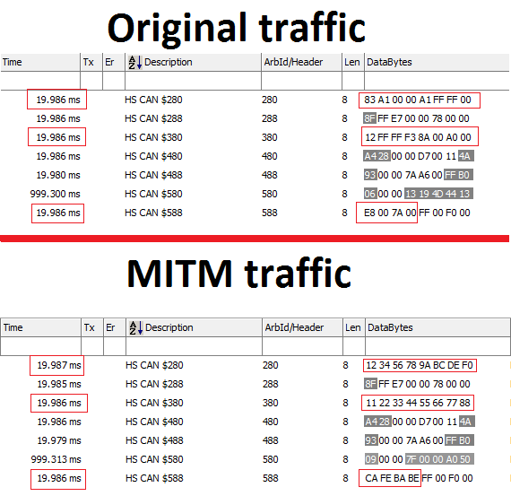
MITM
Handled by the CANBadger Firmware (real-time!)
Rules are set for specific IDS
Manipulate individual bytes:
Swap for fixed value
Add, substract, multiply, divide
Increase or decrease percent
Conditions can be set to:
Whole payload matches
Specific bytes match
Specific bytes are greater or smaller than X value
Notes:
The image will be hard to read, otherwise really good. I suggest putting the original/MITM on a separate sllide in fullscreen so its better to see and explain

Slide 19

CANBadger Server
Remotely control multiple CanBadgers!
Simple UDP Protocol
Node2Server
Node2Node
Cross-Platform
Python
Qt for GUI
Hackable Protocol Abstractions

Slide 20
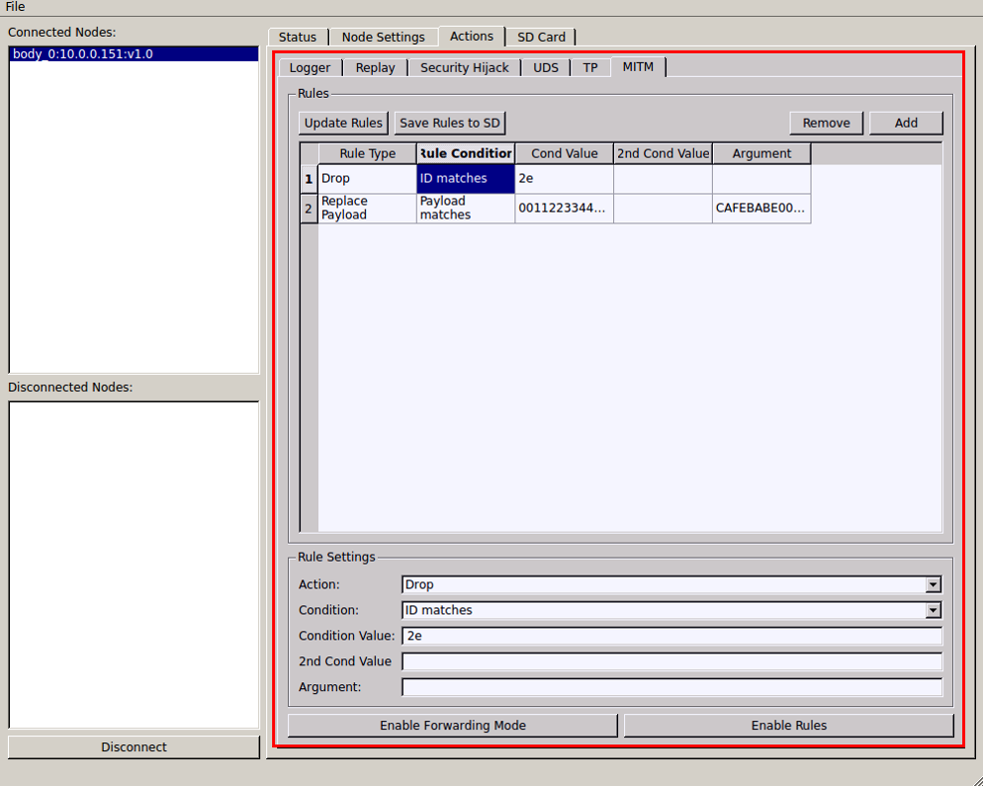
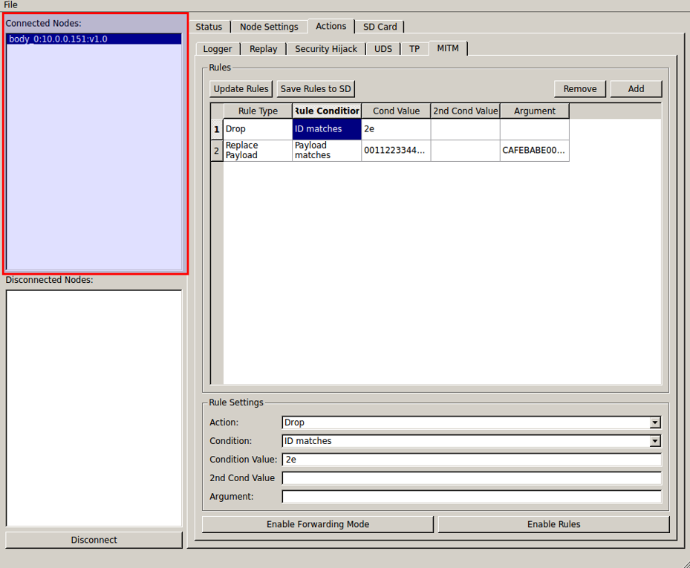
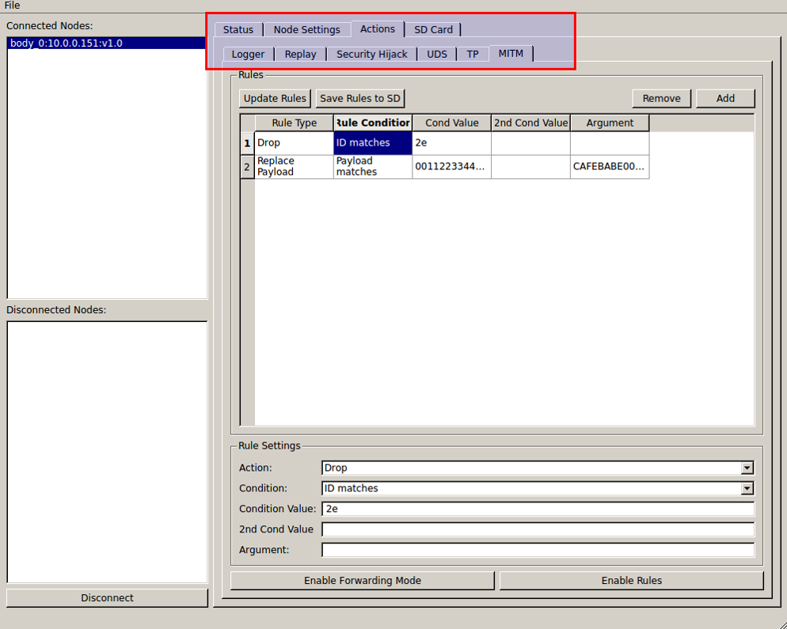
CANBadger Server
Displays status for connected CANBadgers
All operations organized in tabs
Easily modify/add parameters and perform actions
Exchange data between tabs

Slide 21
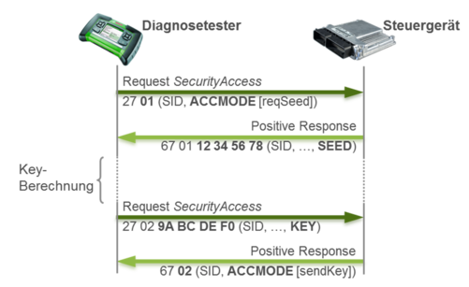
SecurityAccess Hijack. Why?
OEM tools and some third-party tools authenticate themselves to ECUs in order to gain access to restricted features. Who doesn’t like restricted stuff?
These tools have fixed functions, so you have no control over the process other than pressing buttons.
Because you CAN!
Notes:
The text takes too much space, I would just show the image and just say exactly what u wrote here.

Slide 22

SecurityAccess Hijack. How?
Wait for a SecurityAccess request in transparent bridge mode
Switch to the desired type of Diagnostics Session
SecurityAccess auth is forwarded
Success? Cut off the external tool and take control over the Session!

Slide 23

So, we survived the demo (hopefully!)
What else can the CANBadger do?
Dump TP and UDS transfers, which are used for firmware updates.
Spoof OBD2 data thru MITM and Emulator
Use GPIO pins for bootloading (Tricore f.ex)
Manipulate GPS signals via UART pins

Slide 24
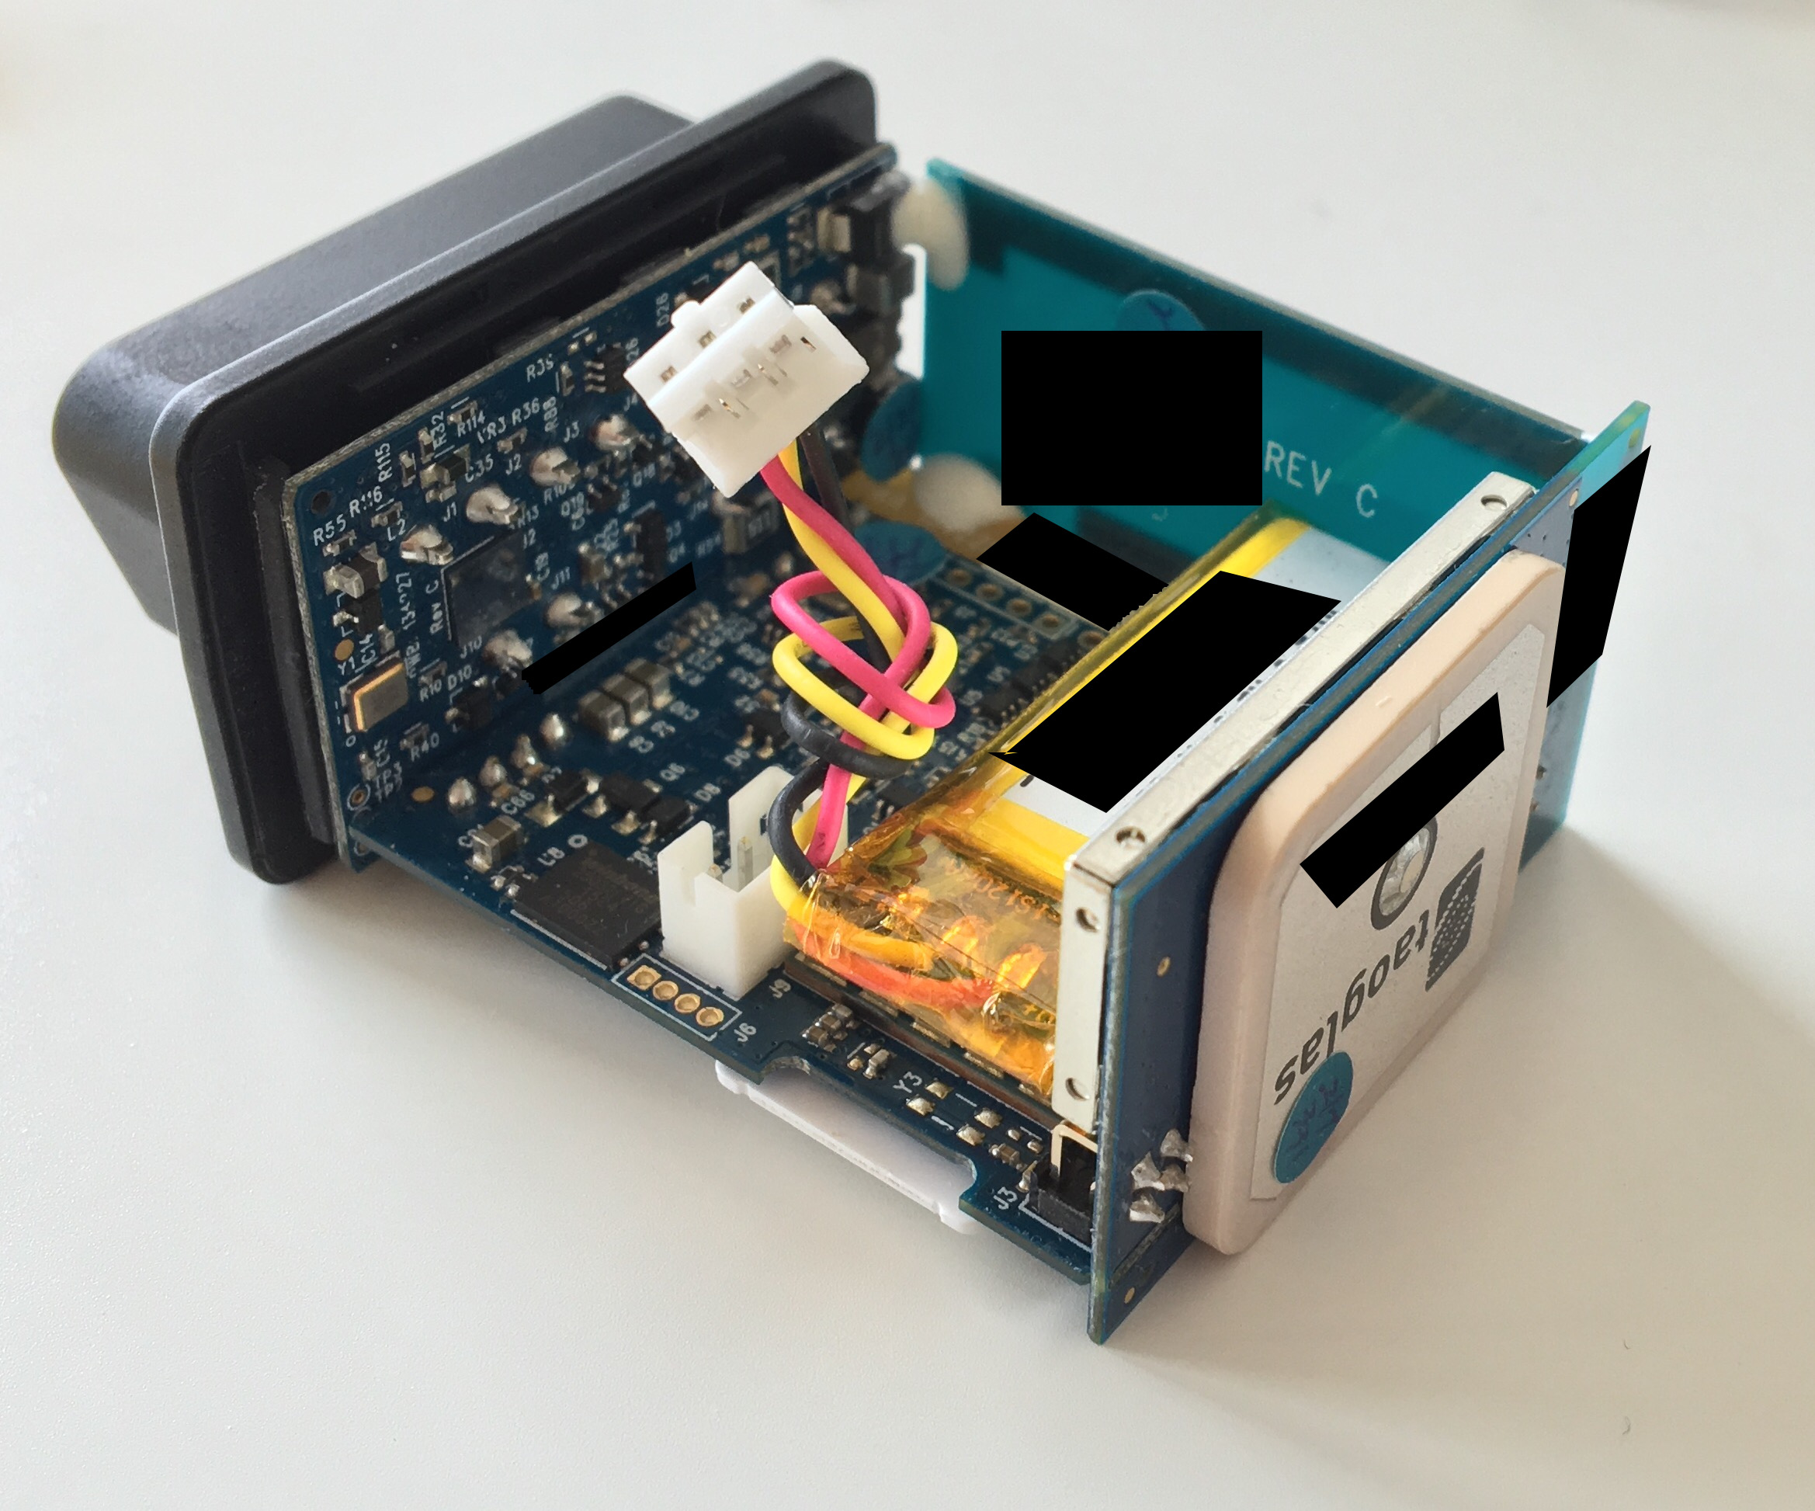
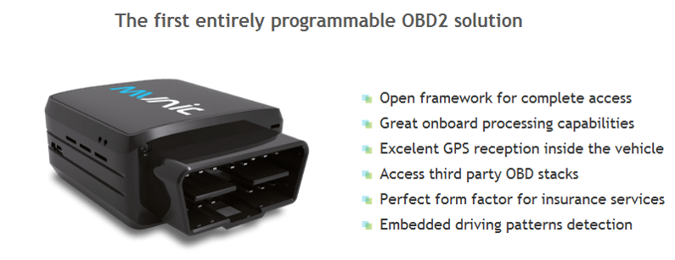

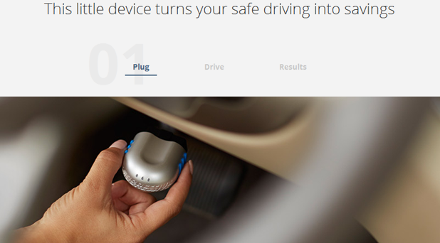
Wait, why did you mention GPS?

Slide 25
Insurance and Tracking dongles
They implicitly trust the car though they cannot really know where the OBD2 data is coming from
They are dependent on a GPS module that outputs data via UART
By spoofing the OBD2 data, you can have your own “driving habits”
By spoofing your location, well, you can guess… ☺
Mix both of them
???
Profit!

Slide 26
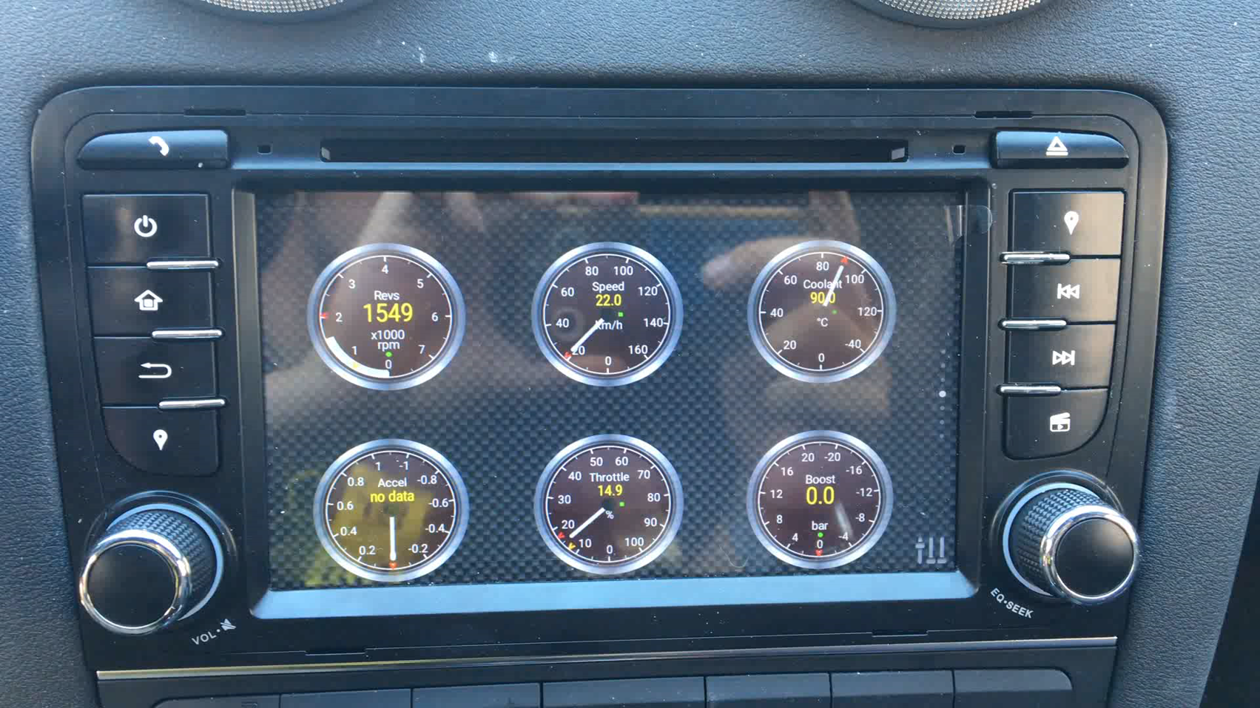
Insurance and Tracking dongles

Slide 27
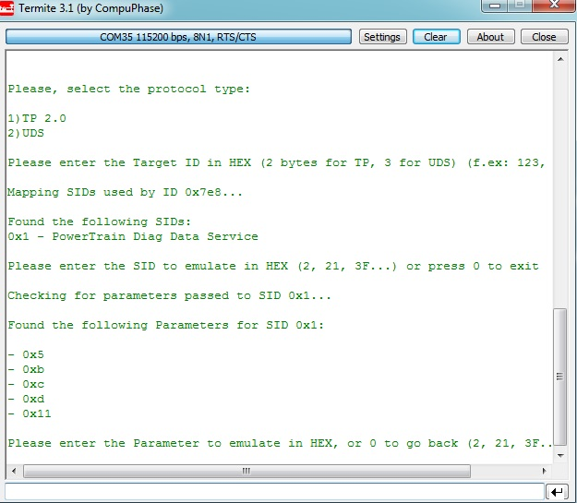
How does the emulator work?
The CANBadger will make requests for specified PIDs every 10 ms in a loop during desired time, dumping the replies to SD.
Once the data is stored, you can choose from which IDs, SIDs and PIDs you want to create emulation files.

Slide 28
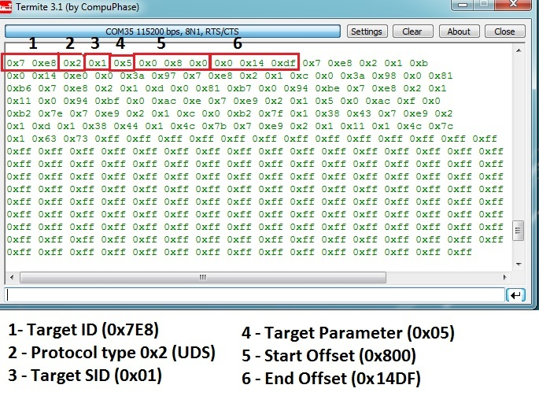
How does the emulator work?
The emulator data is mapped into the XRAM.
The first 0x800 bytes are lookup tables which contain ID, Protocol, SID, PID, Start Offset and End Offset
All requests from the victim are passed to the target system.
When a reply is received from the target, the CANBadger will lookup these tables to see if an entry is found for it.
If an entry is found, it will pass the emulated data instead of the original one.

Slide 29
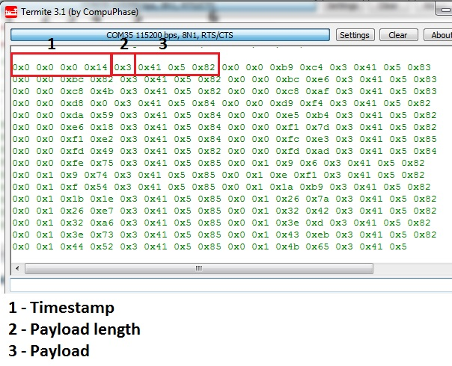
How does the emulator work?
Emulation data is stored with timestamps.
The CANBadger will pass the appropriate data for each moment, so even if requests are random, data will still be right.
The emulation data is optimized, storing only changes within the timeframe.
When there is no more emulation data left for the current timeframe, the whole emulation will be restarted from the beginning

Slide 30
Wanna see moar?
We will be waiting for you at the “You CAN haz car secretz” workshop, ready to answer all your questions and to provide more info.
Do you want to assemble your own CANBadger like, right now? Come visit us!
Code and schematics are GPL and will be uploaded to github shortly after DC
Notes:
Changed “after a week” to “shortly after DC”

Slide 31

Thanks!
To all of you for being here today!
To Code White for their support and trust in the project
To our family and friends for supporting us even when we run out of coffee
Javier Vazquez
@fjvva
Javier.Vazquez.vidal@code-white.com
Ferdinand Nölscher
@s1ckcc
Ferdinand.noelscher@code-white.com

